Slide 1
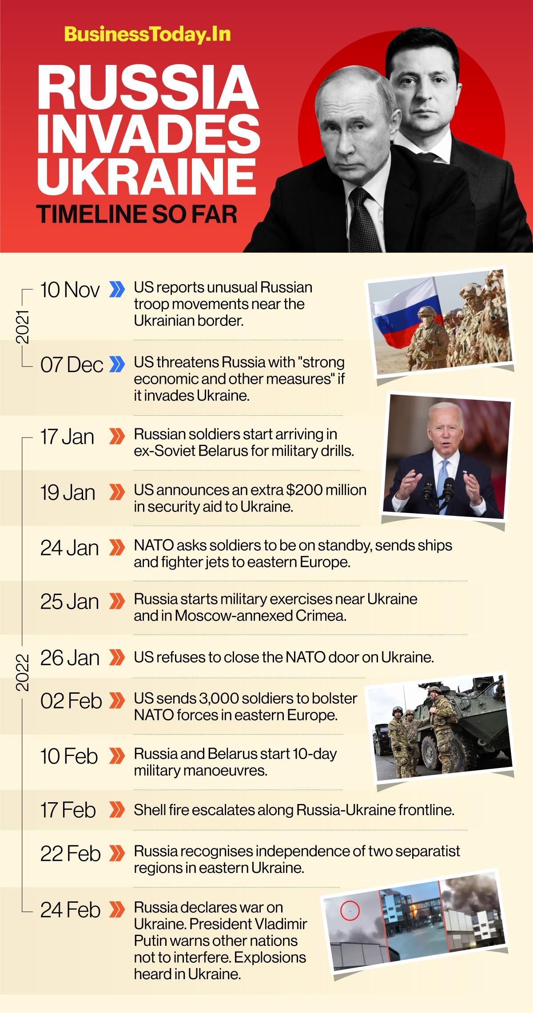
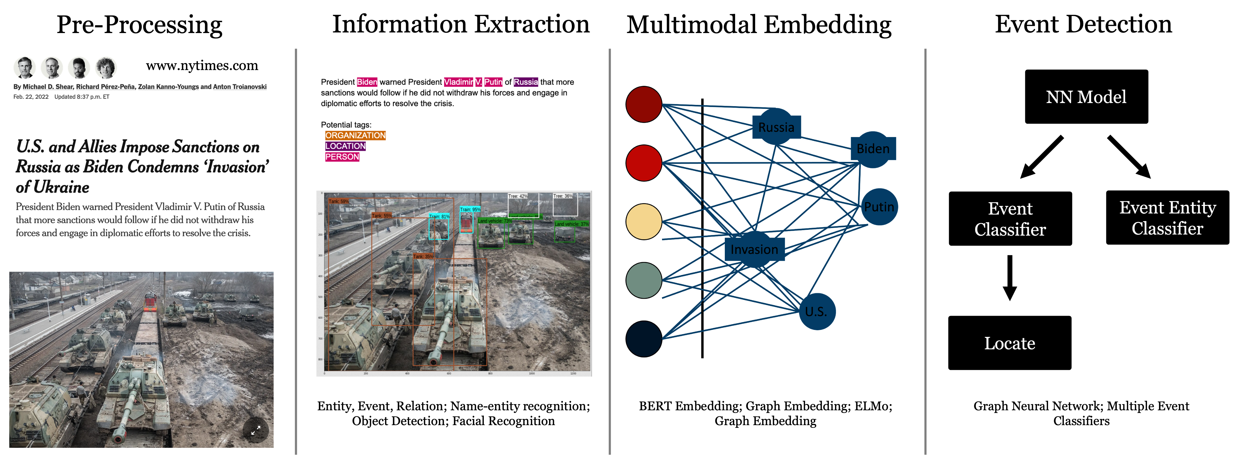
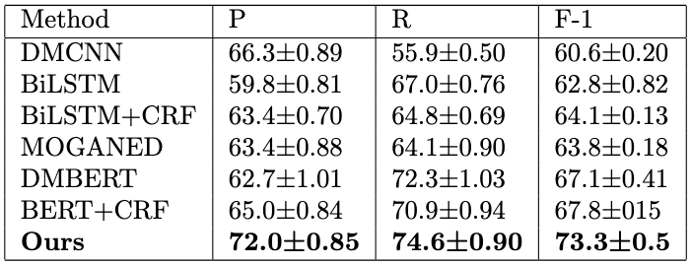
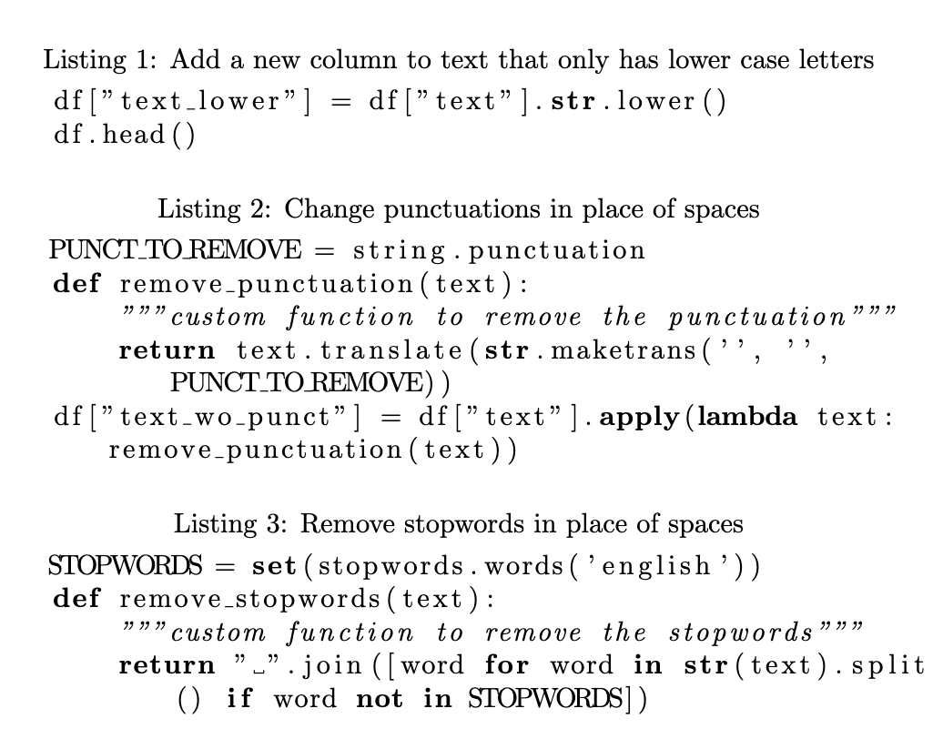
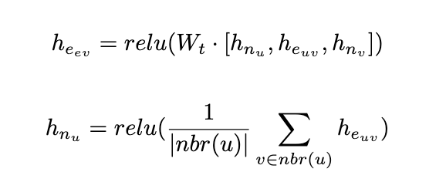
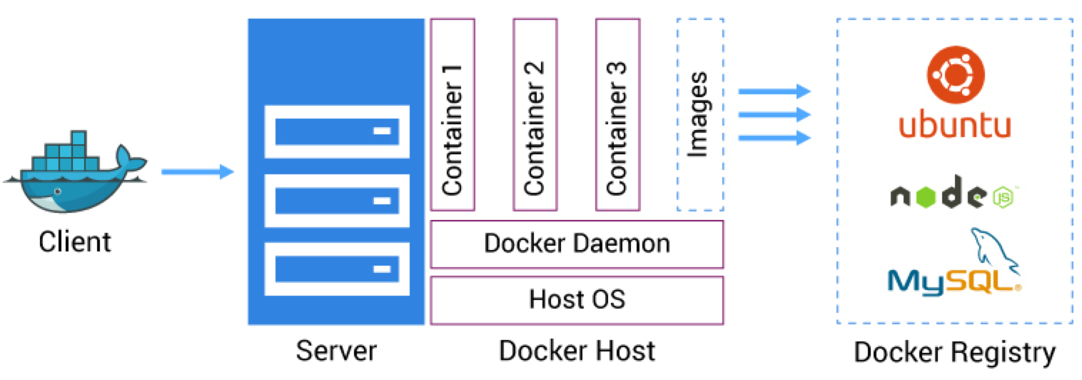
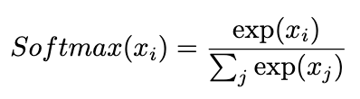
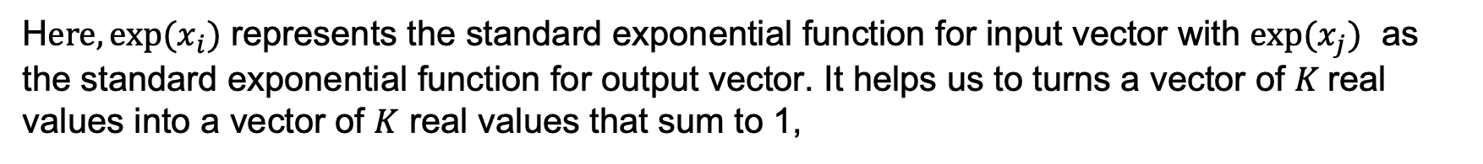
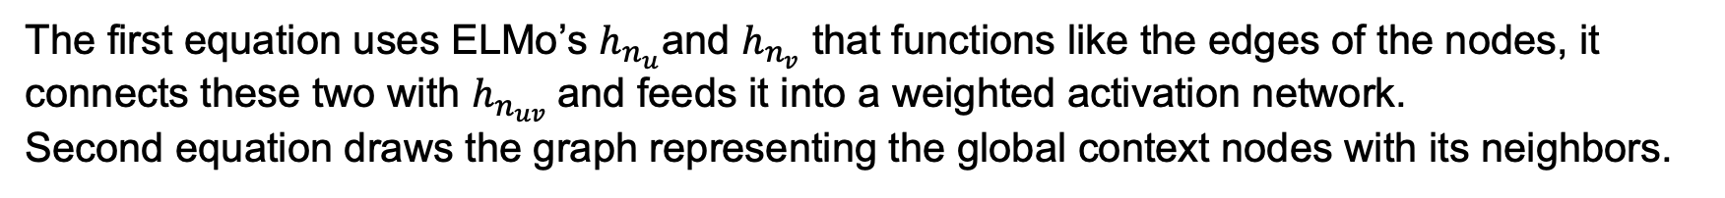
Dockerized Knowledge-Oriented Multi-modal Social Event Detection System
Multi-modal Social Event Detection
ROBO 625 | Yuting Lyu | Moses Brown School
Experiments
Our research seeks to understand the complex events described in the multimedia input by developing a semi-automated system that identifies, links, and sorts its subsidiary elements, involved participants, and complex event types in chronological order. We propose a systematic analysis of world events: such as the Boston Marathon bombing, Capital Riots, Covid-19, etc.
Overview of System Framework
In this experiment we use MAVEN(Wang et al., 2020), one of the most recent datasets which contains 168 event types, 4480 Wikipedia documents, and 118,732 event mention instances.
For the second choice of the dataset, we selected 120 videos from the internet and processed them through our system.
Extensive results show that our system outperforms other state-of-the-art systems.
Our dataset shows that our method accuracy is 75.4, the recall is 80.2, and the F-1 is 77.7, respectively.
There are four steps in building the system: 1.Pre-processing, 2.Information Extraction, 3.Multimodal Embedding, 4.Knowledge-Oriented Event Detection. In pre-processing, we prepare the unstructured data to optimize the outcome by removing excess information that is in the way, such as punctuations, stopwords, frequent words, and rare words. In information extraction, we analyse the data by turning it into structured knowledge, classifying entities, and identifying objects. In multimodal embedding, we use word embedding, graph embedding, and background embedding to use vectors to link related information together. In Knowledge-Oriented Event Detection, we build a Knowledge Graph to understand complex world events.
Conclusion & Insight
Our project assembles a knowledge-oriented system that can identify and analyze these data and complex events.
Dockerized system can comprehend the elements, which incorporates various data types such as images, text, video and audio.
Fully analyzes world events like the Boston Marathon bombing, capital riots, and Covid-19 to a level of sophistication.
Knowledge-Oriented Multimedia Event Detection System
1. Pre-processing uses the following lines of pseudo code to get rid of extra information such as punctuations, stopwords, frequent words and rare words.
3. Multimodal embedding combines both visual and textual information to improve performance. BERT is primarily used here for background embedding. We create word vectors using BERT and ELMO (B-LSTM) and graph embedding through an IE system that will construct a Knowledge Graph.
Future Work & Discussion
For future work we hope to share a demo of the system publicly on a website as well as comprehend more languages than just English alone. Using the wrong results may affect the understanding of events, leading to unreasonable decisions to believe in a particular person/idea.
Dockerized Knowledge-Oriented System
The first equation uses ELMo’s $h_{n_{u}}$and $h_{n_{v}}$ that functions like the edges of the nodes, it connects these two with $h_{n_{uv}}$and feeds it into a weighted activation network.
Second equation draws the graph representing the global context nodes with its neighbors.
References & Acknowledgements
Dockerized system can both emulate the target platform and cross-compile through multiple scenarios.
4. Based on multimedia graph feature expression, Semantic features that are useful for identifying causal relations are also created. We then merge the extracted graph features using AVG and MAX pooling. And though a Softmax function, we treat it like a multiple edge classification problem.
(Devlin, Chang, Lee, & Toutanova, 2019; Wang et al., 2020; Doddington et al., 2004; Nguyen & Grishman, 2015; Zhao, Jin, Wang, & Cheng, 2018; Chen, Xu, Liu, Zeng, & Zhao, 2015 etc.) For more references, please see our paper.
We are very thankful for CMU’s Linux servers as well as various different publicly available classes that are up on Youtube as they’ve helped us a lot through the basics as well as their website.
2. There are three steps in Information Extraction: 1.Extract Entity, Events and Relations model, 2.Named-Entity Recognition (NER), 3.Object Detection/Facial Recognition.
H$ere, exp⁡(x_{i})$ represents the standard exponential function for input vector with $exp⁡(x_{j})$ as the standard exponential function for output vector. It helps us to turns a vector of $K$real values into a vector of $K$ real values that sum to 1,

